Slide 1

SOLELY FOR PURPOSES OF FORAGE WORK EXPERIENCE
Predicting customers' buying behaviour
Obinna Oliseneku

Slide 2

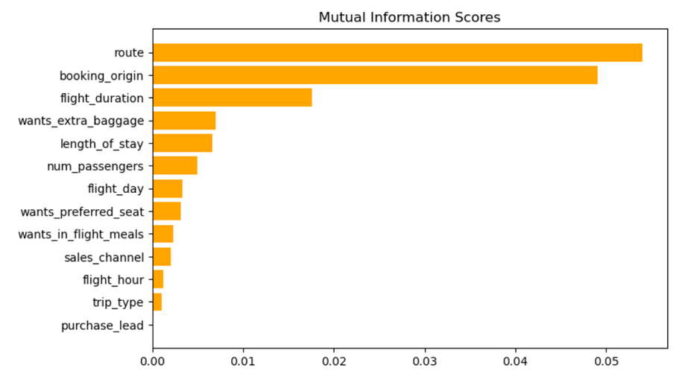
SOLELY FOR PURPOSES OF FORAGE WORK EXPERIENCE
Insights Predictive Modelling
Random Forest Model Details
Variable Contribution to Model
Route',
'booking_origin',
'flight_duration'
'wants_extra_baggage'
'length_of_stay',
'num_passengers
Appear to be the 6 most important features
Accuracy: 85.09
AUC score: 0.5577

